Slide 1
Email Alert if Public IP address changes - Updated
Karthikeyan K 2018103549
Jim Tony B 2018103543
Bharath S 2018103519
Dhanush Kumar K 2018103022

Slide 2
Introduction
In this we designed and implemented an IoT (Internet of Things) platform for getting public IP address and checking whether it changed using the Node-RED platform.
Node-RED allows us to wire together nodes to create flows, which carry out our programming task.

Slide 3
System overview
The system obtains the current public IP address via https://ident.me
Passes the result through a 'switch' node programmed only to accept data in the format of a IP address - regex validity check.
The IP address is then compared to the previous recorded IP address, and if they differ - then an email is sent to the email address provided, otherwise the flow ends.
The IP address check will be triggered for every 1 min.

Slide 4
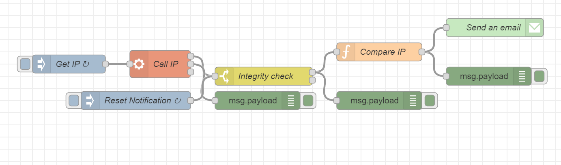
Flow

Slide 5
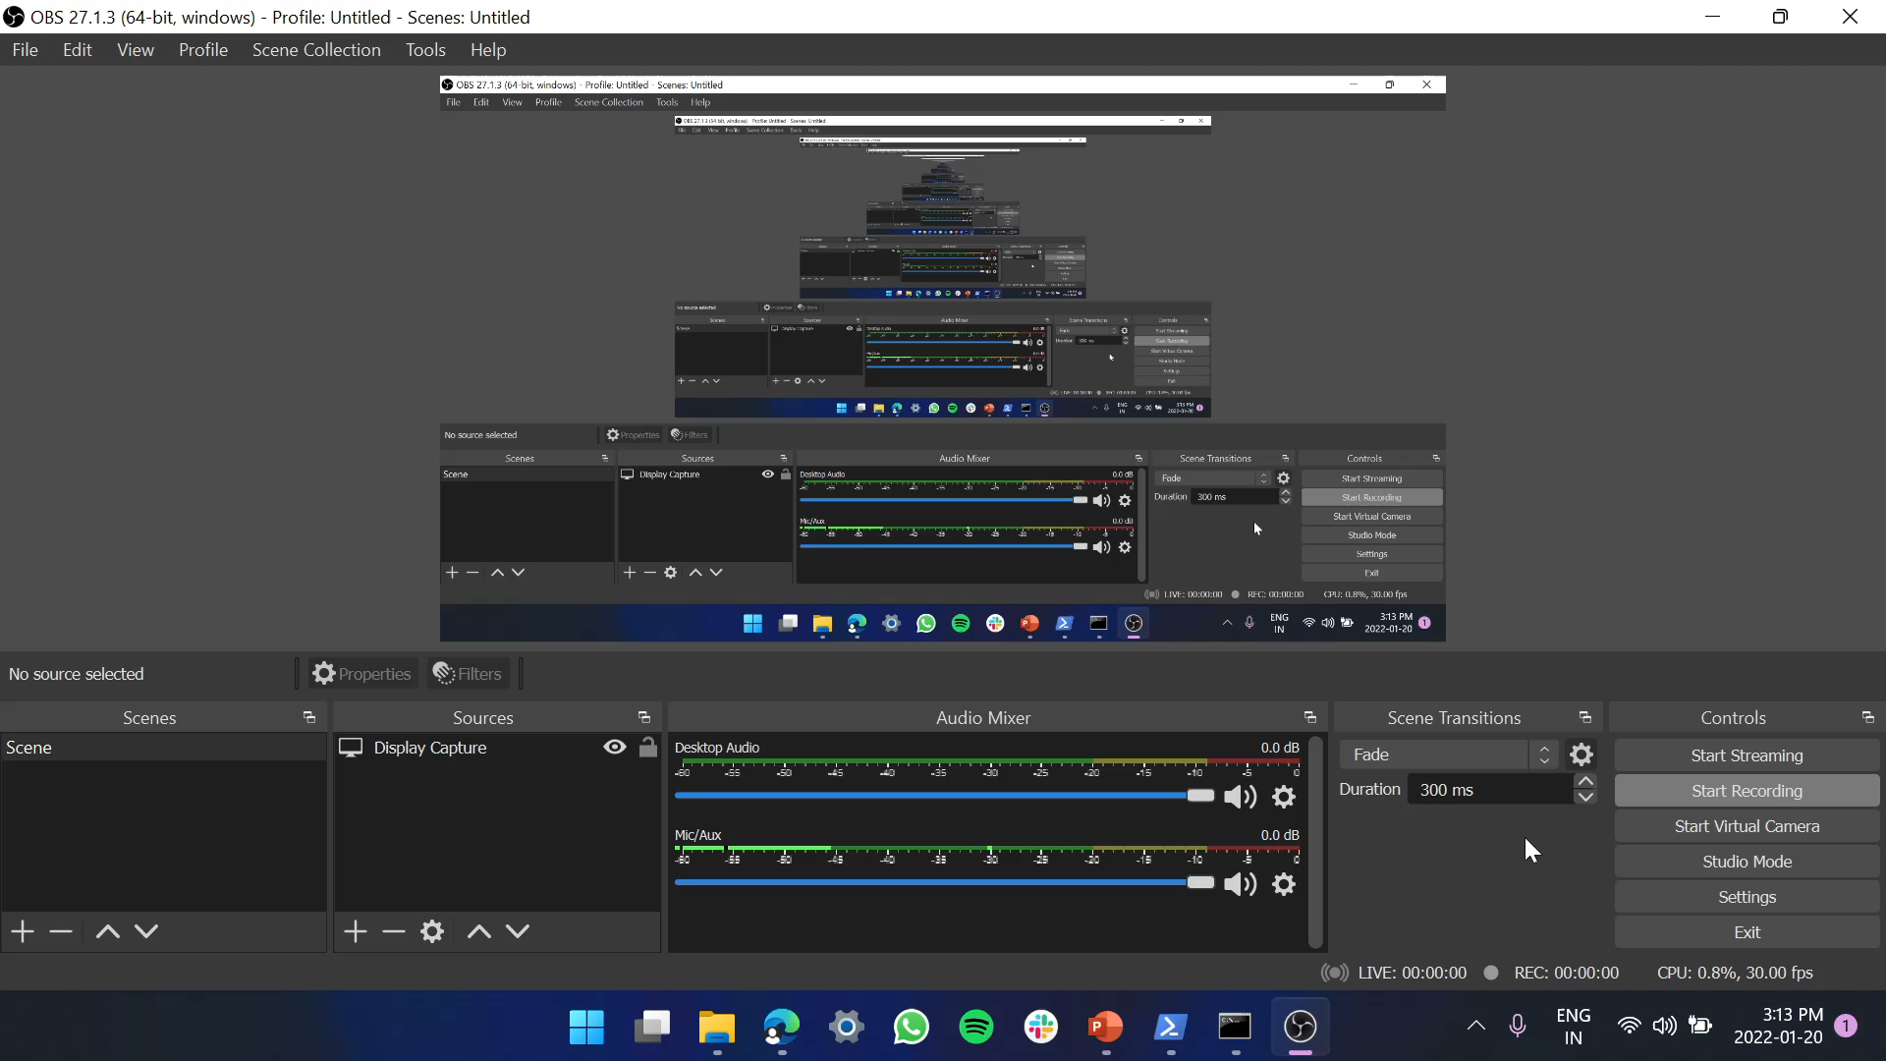
Video simulation

Slide 6
Node red installation and deploying the system
Install Node-Red
open a browser at the address http://127.0.0.1:1880/ , where the node-red MVC flow is.
Create the flows as mentioned in the previous slides.
Enter the email address and password
Enter the recipient email address
Deploy the Flows
In order to see the ui results of running the code you should open a browser tab at the address http://127.0.0.1:1880/ui/, where the dashboard is.

Slide 7
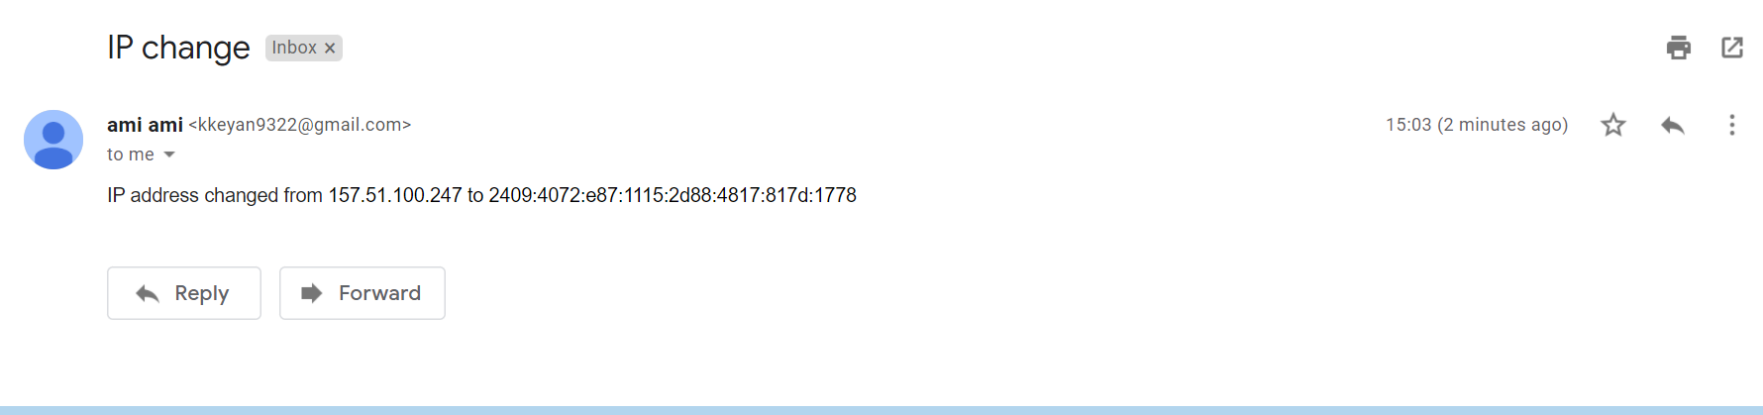
Mail

